Slide 1
Innoprom 2020 Online-Session: STANDARDIZATION AS BASIS FOR INDUSTRY 4.0 Advantages of participating in Industrie 4.0 for SIEMENS AG - why Russia and Germany will co-operate for Industrie 4.0 - Markus Reigl (Dipl.-Ing., M.A.) Director of technical regulation and standardization at SIEMENS AG.
Moscow, 7th July 2020

Slide 2
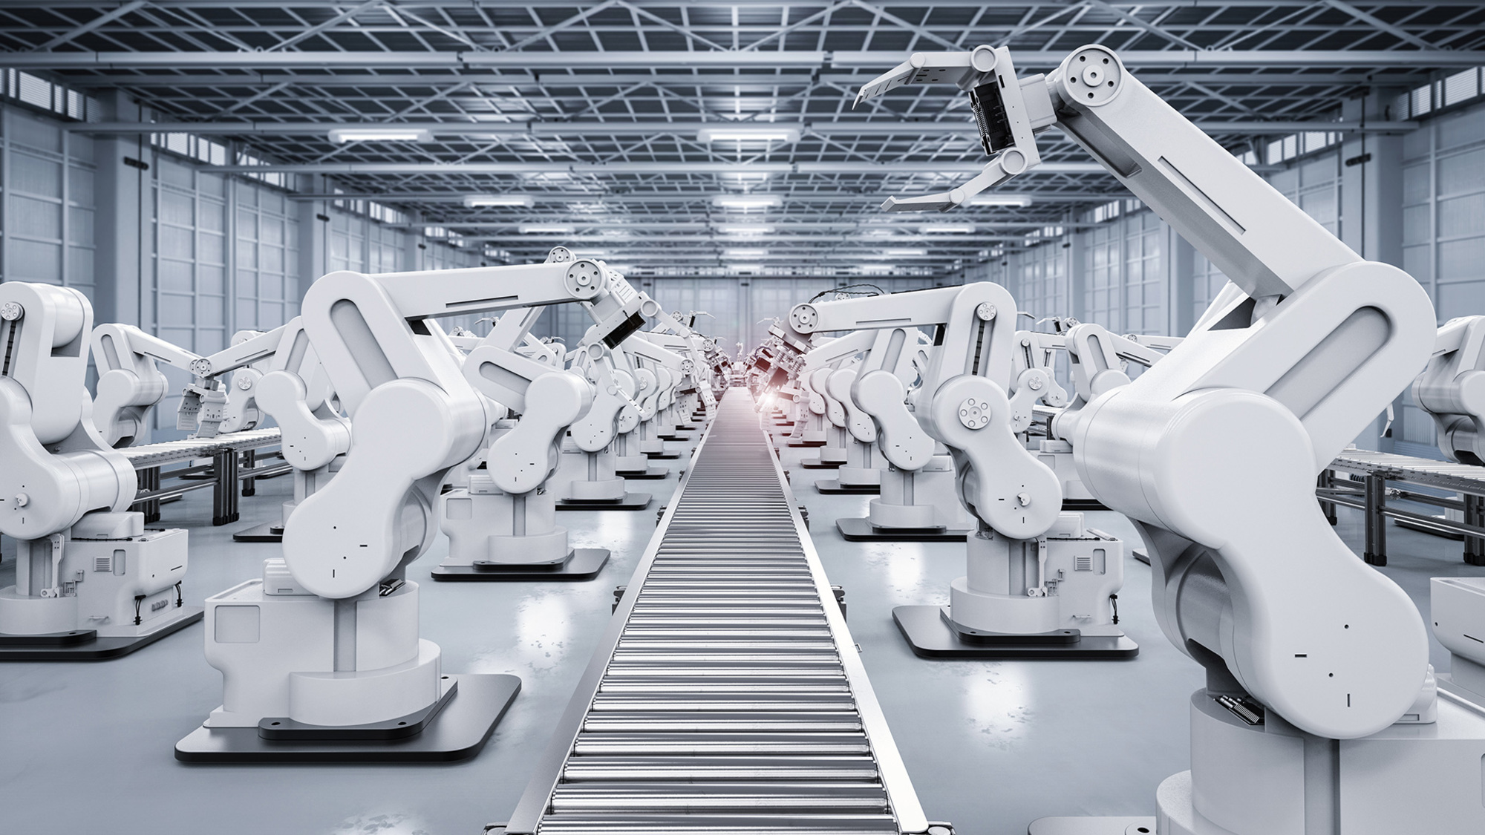
Цитата из лекции Г-н Буркхарт Дахмен
„Industrie 4.0“ a German Invention (for the world market)
Completely networked manufacturing
National solutions are a phase-out model
Cloud solutions are preferred
Digitalization of all industrial process including Sales, Services and Logistics
Simulation Software Digital Twin
Common technical language is required ➔ Standardisation ➔ Standards ➔ раз, два, три !

Slide 3
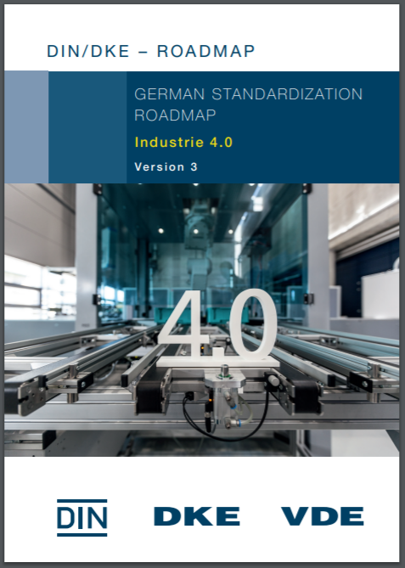
Раз
Make a Plan („Standardization Roadmap“)
https://www.din.de/en/innovation-and-research/industry-4-0/standardization-roadmap
Collect Use Cases
Determine Concepts
Identify Technologies
Identify need of standards
Complement existing stds.
Develope new ones
Why not make
a Russian
version?

Slide 4
Два
Define an Architecture
Standardisation
Experts
IEC PAS 63088:2017
МЭК ПАС 63088
Интеллектуальное производство. Модель эталонной архитектуры industry 4.0

Slide 5
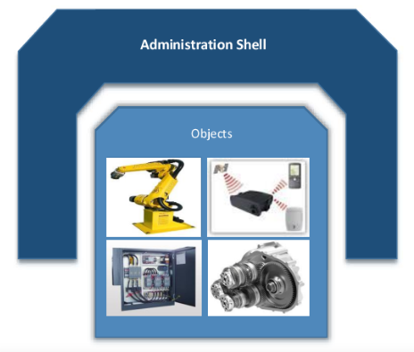
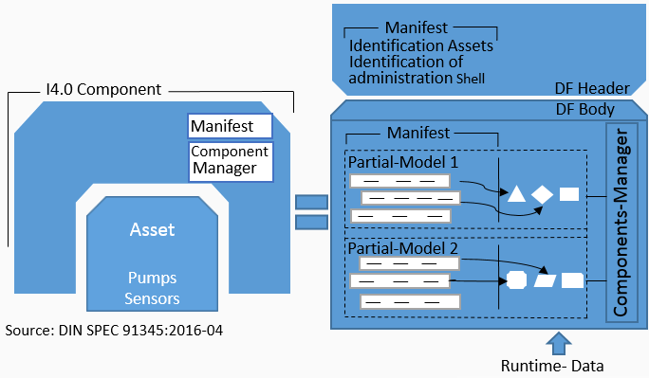
Три
Elaborate on specific elements (make standards)
e.g.
the concept of the AAS (Asset Administration Shell) as a key element of Industrie 4.0 realisation
https://www.plattform-i40.de/PI40/Redaktion/EN/Downloads/Publikation/vws-in-detail-presentation.html
Coding
„Nerds“
Work Item in
IEC/TC65

Slide 6
аппелировать:
давайте работать вместе

Slide 7
Большое спасибо за ваше внимание Приветствия нашим друзьям в России
Moscow, 7th of July 2020

