Slide 1
2004 - RSPP COMMITTE HAS 16 YEARS OLD - 2020
г. Астана, 25 февраля 2011 г.
WORK OF THE COUNCIL ON TECHNICAL REGULATION AND STANDADIZATION IN DIGITAL ECONOMY
Andrey LOTSMANOV
First Deputy Chairman of the RSPP Committee
on technical regulation, standardization and conformity assessment
Chairman of the Council for technical regulation and standardization under the Ministry of industry and trade of Russia
WWW.RGTR.RU RGTR@RSPP.RU

Slide 2
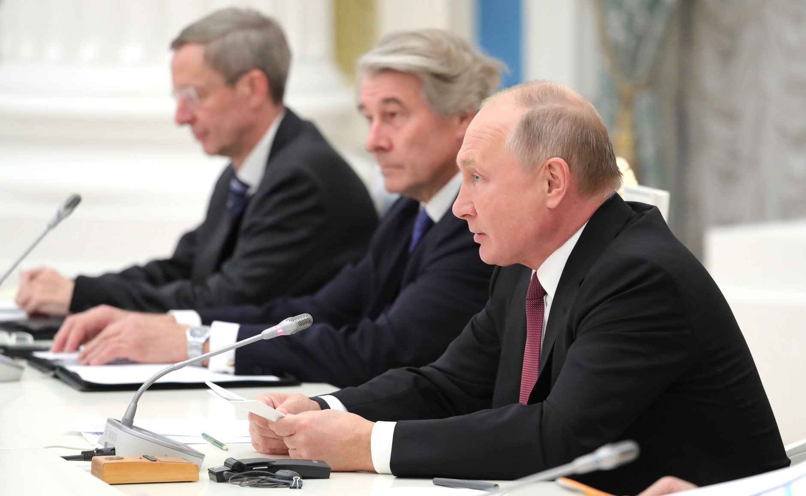
07.12.19 MEETING of VLADIMIR PUTIN
WITH THE OAOEV DELEGATION
Из презентации О. Гермеса,
Председателя Восточного комитета германской экономики.
Конференция «Промышленная политика в контексте
сложных геополитических вызовов»
12.09.2019, отель Лотте-плаза, Москва

Slide 3
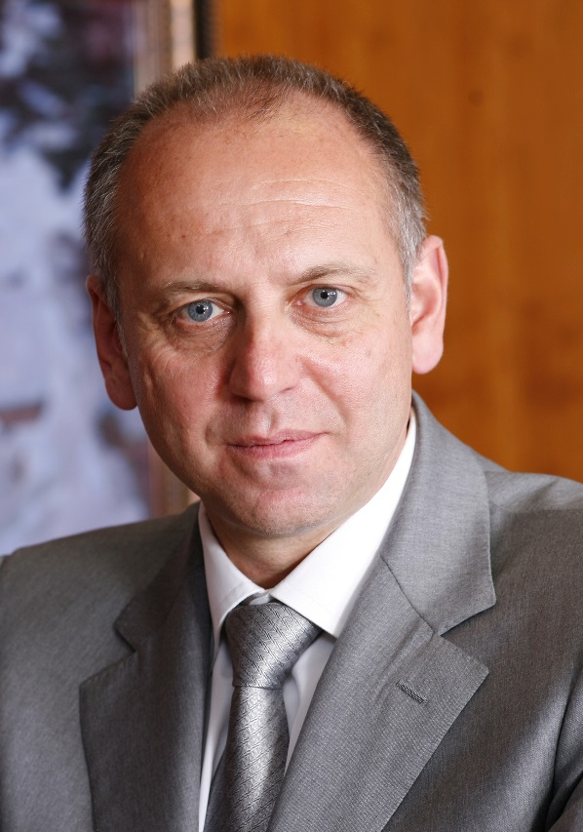
WORK OF THE RSPP COMITTEE ON TECHNICAL REGULATION, STANDARDIZATION AND CONFORMITY ASSESSMENT
The Committee was established in 2004.
The RSPP Committee is attended by more than 2,500 experts from all industries.
The work of the RSPP Committee allows the industry to:
Actively participate in the development of technical regulations and regulatory legal documents.
Develop consolidated opinions of various industries on issues of technical regulation, standardization and conformity assessment.
Carry out interaction of industrial associations with state authorities.
Expand international cooperation in the field of technical regulation and standardization.
DMITRY PUMPYANSKY
Member of the RSPP Board,
Head Of The Committee,
Chairman Board of Directors, TMK
Notes:
Комитет РСПП по техническому регулированию, стандартизации и оценке соответствия был образован в 2004 году. Бессменным Председателем Комитета является Дмитрий Александрович Пумпянский - Член Бюро Правления Российского союза промышленников и предпринимателей, председатель совета директоров ПАО «Трубная металлургическая компания».
В настоящее время в его составе работает более 2000 экспертов от предприятий и организаций из всех отраслей промышленности, представляющих все регионы России, а также страны Евразийского экономического союза. В том числе экспертов из представительств европейских компаний, работающих в России.
Они принимают самое активное участие в обсуждении проектов технических регламентов, постановлений Правительства и федеральных законов в области технического регулирования и стандартизации, в разработке и обновлении национальных и межгосударственных стандартов.
<номер>

Slide 4
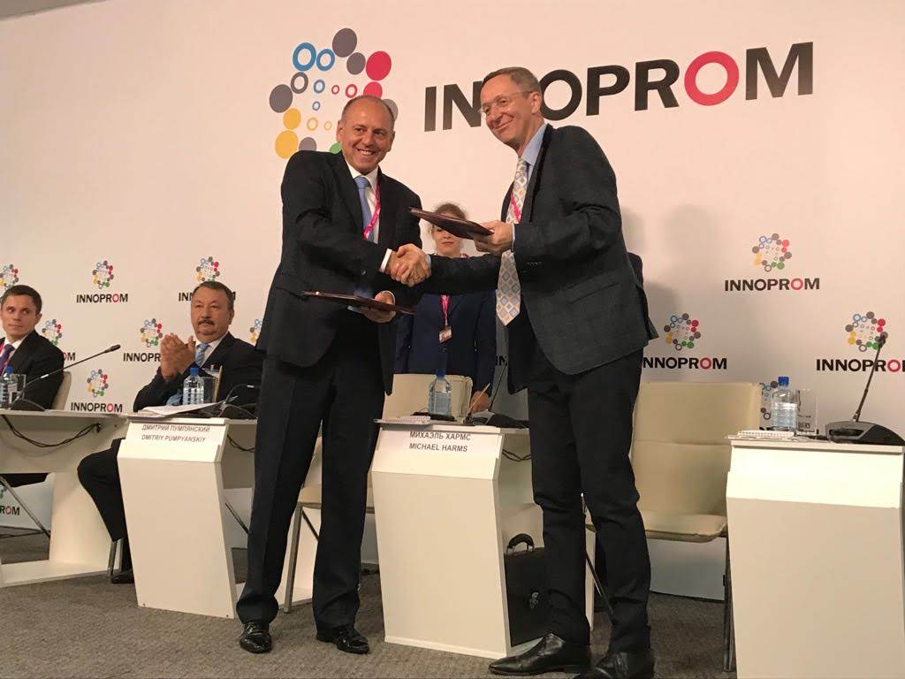
SIGN THE AGREEMENT
RSPP-EASTERN COMMITTEE OF THE GERMAN ECONOMY
ON 10 JULY, 2018 ESTABLISHED A COUNCIL FOR TECHNICAL REGULATION AND STANDARDIZATION FOR DIGITAL ECONOMY ENTREPRENEURS AND THE EASTERN COMMITTEE OF GERMAN ECONOMY

Slide 5
NEW CHALLENGES OF STANDARDIZATION –
NEW AREAS OF COOPERATION
The current systems of standardization and conformity assessment were developed more than a hundred years ago in the conditions and for the needs of the second industrial revolution
The new industrial structure is based on digital technologies and digital standards
Notes:
<номер>

Slide 6
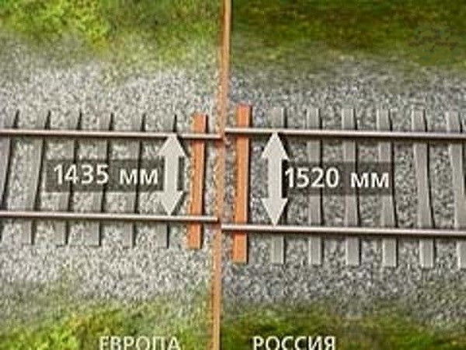
DIFFERENT STANDARDS ARE INSURMOUNTABLE BARRIERS
EUROPE
RUSSIA

Slide 7
INDUSTRY 4.0 Platform working groups in Germany
№ 1 Reference architecture, standards and norms
№ 2 Scenarios for using the technology
Without it standards it is impossible to create an industry 4.0 Platform
This is a governamental task
№ 3 The security of network systems
№ 4 Legal base
№ 5 Work, eduction, professional trainings
№ 6 Digital business models in Industry 4.0
<номер>

Slide 8
STRUCTURE OF THE COUNSIL ON TECHNICAL REGULATION AND STAB+NDADIXATION FOR DIGITAL ECONOMY
LEADERSHIP
Russian side
Dmitry Pumpyanskiy
German side
Burkhard Dahmen
Expert groups
1 Quality infrastructure
2 Digital transformation
Quality infrastructure
Technical regulations
Horizontal aspects
Vertical applies
Standardization
Construction materials
Ontology and Semantics
SMART GRIDS
Accreditation
Railway transport
Conformity asessment
Machinery
Cybersecurity
Smart manifacturing
4
Notes:
<номер>

Slide 9
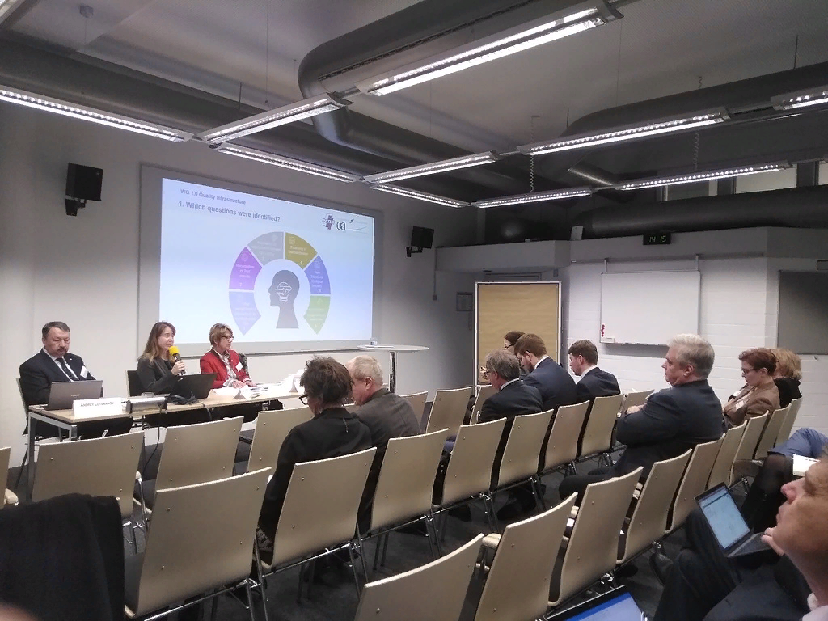
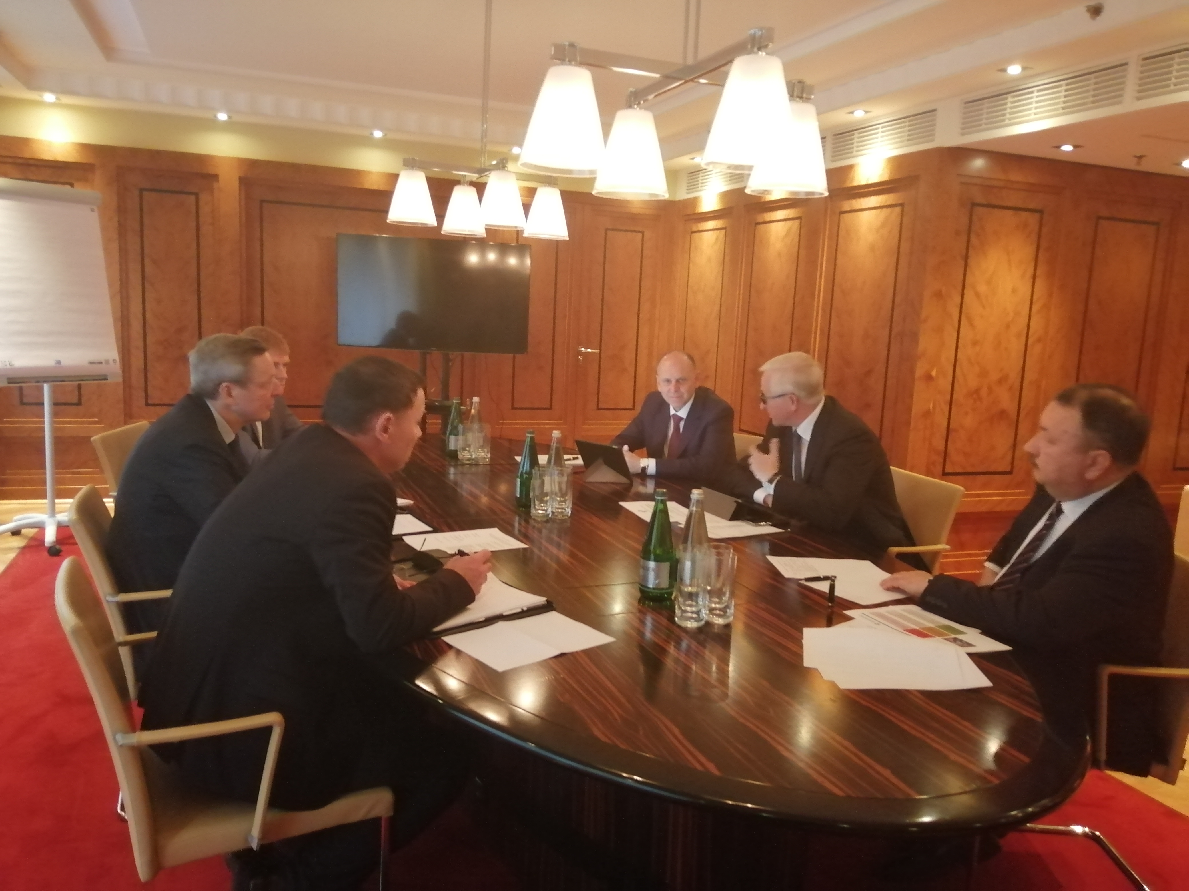
MAIN EVENTS OF THE COUNCIL
December 11-13, 2019
Council meeting in SIEMENS Conference Hall, Munich
February 18, 2020
Meeting of the Council“s leadership
It was decided to create a website for the Council in three languages-Russian, German and English.
July 03, 2020
Meeting of the Council in online format. More than 40 participants.

Slide 10
RESULTS OF EXPERT GROUPS ' WORK
(based on the results of the online session 03.07.2020)
The "Quality Infrastructure" direction.
- Formation of an analog of the industry 4.0 Platform in Russia.
- Creating conditions for digital conformity assessment of products and conducting virtual tests.
The direction of the "Technical regulations".
- Work on harmonization of Russian and European standards and conditions for certification of products in the field of railway transport and construction materials.
- Creating conditions for the implementation of the pilot project "Exemplary order fulfillment by an industrial enterprise".
The direction of "Digital transformation".
- Developed a Glossary of terms for Industry 4.0 in Russian, English and German.
- The Codex consortium, based on the eCl@ss classifier, has started developing a specialized product in the field of normative reference systems.
- Work has begun on the implementation of the project "Digital systems for dynamic monitoring of the state and operating modes of overhead power lines with a voltage of 35-220 kV", which will significantly reduce the cost of repairing and operating networks.
<номер>

Slide 11
COUNCIL ON TECHNICAL REGULATION AND STANDARDIZATION FOR THE DIGITAL ECONOMY
Business:
State bodies:
Росстандарт
Notes:
<номер>

Slide 12
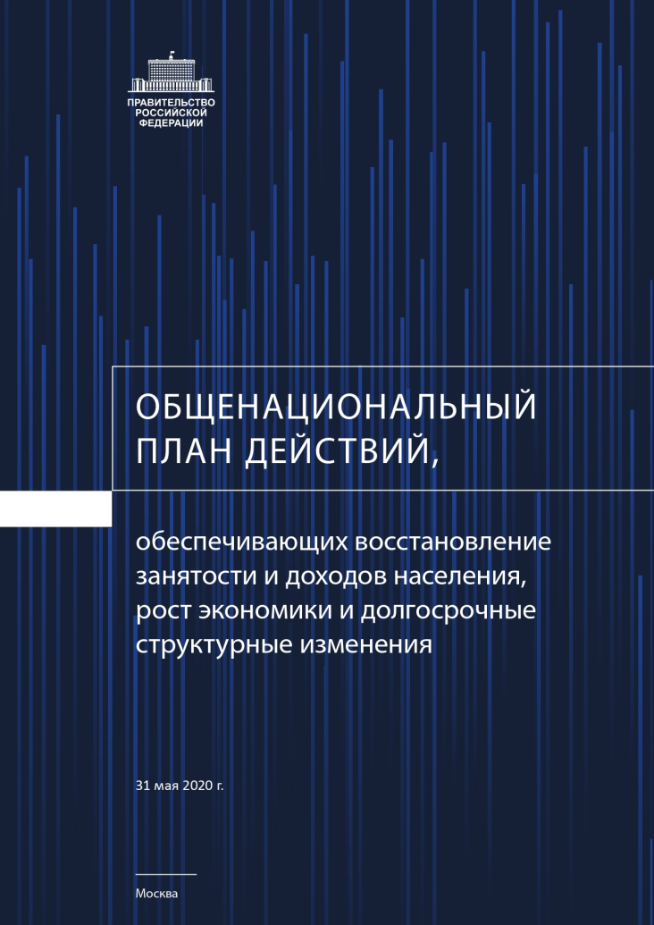
PROPOSALS OF THE RSPP COMMITTEE
to the draft "National action plan"
ensuring the restoration of employment and income of the population, economic growth and long-term structural changes."
Transition of industry to modern planning and management methods based on analogs of "Industry 4.0" platforms.
Preparation of an interdepartmental plan for the development and creation of a national platform
"Russian industry 4.0".
Approval and implementation of the program development and implementation, IT standards for the platform "the Russian Industry 4.0".
Notes:
<номер>

Slide 13
СХЕМА ВЗАИМОДЕЙСТВИЯ
THANK YOU
For ATTENTION
(495) 663-04-50
RGTR@RSPP.RU
www.RGTR.RU
Joint us at Facebook: https://www.facebook.com/www.RGTR.ru/

