Slide 1

2004 - RSPP COMMITTEE HAS 15 YEARS OLD- 2019
RESULTS OF THE COUNCIL'S ACTIVITIES FROM THE RUSSIAN SIDE FOR 1ST QUATER OF 2019
Andrey Lotsmanov
Firs deputy Head of RSPP Committee for technical regulation, standardization and conformity assessment
Chairman of Council for technical regulation and standardization under Russian ministry of industry and trade
г. Астана, 25 февраля 2011 г.
WWW.RGTR.RU RGTR@RSPP.RU

Slide 2
THE COUNCIL ON TECHNICAL REGULATION A
ND STANDARDIZATION FOR THE DIGITAL ECONOMY
MANAGEMENT
Russian side
D. Pumpyanskiy
German side
B. Dahmen
WORKING GROUPS
1 Quality infrastructure
2 Digital transformation
Direction 1
“Quality infrastructure”
Direction 2
“Technical regulations”
Direction 3
HORIZONTAL ASPECTS
Direction 4
VERTICAL ASPECTS
Standardization
Construction materials
Structure templates and Interoperability and the Internet of things
Smart manufacturing
Accreditation
Railway transport
Cybersecurity
Smart GRID for electricity
Conformity assessment
Machinery
Ontology and semantics
BIM-technologies
Market surveillance
4

Slide 3




PROJECT STATUS FROM THE RUSSIAN PERSPECTIVE: QUALITY INFRASTRUCTURE
DIRECTION | WORKING GROUP | Co-conveners
 |  | Russia | Germany (Russian proposals)
Quality infrastructure (Coordinators: A. Lotsmanov, J. Krause (Chemnitz University) | Standardization | Lotsmanov (RSPP) | DIN
 | Accreditation | Volkova (NSC “Testing and diagnostics”) | DAKKs
 | Conformity assessment | Bondar (ASSTR) | DAKKs
 | Market surweillance | Soldatov (BSH Russia) | VDMA
Technical regulations Quality infrastructure (Coordinators: A. Lotsmanov, J. Krause (Chemnitz University) | Railway transport | Gapanovich (RZD) | Martin Taulbat (SIEMENS AG)
 | Construction materials | Kozhina (Souyzement) | KNAUF
 | Machinery | Pozdneev (STANKIN) | Thomas Krause

Slide 4
PROJECT STATUS FROM THE RUSSIAN PERSPECTIVE: DIGITAL ECONOMY
DIRECTION | WORKING GROUP | CONVENERS
 |  | Russia | Germany
Digital Transformation, Horizontal aspects (conveners: Golovin (TC-ITC-22, Reigl (SIEMENS) | Architectural frameworks | Bogachev (Zyfra) | Guido Stephans Siemens AG
 | Ontology and semantics | Tikhomirov (KODEKS) | Kai Garrels ABB
 | Cybersecurity | Timofeev (TC-ITC 22) | Volker Jakumeit, DIN
Digital transformation, Vertical integration (conveners: Golovin, Reigl) | Smart Grids for electrotechnics | Fokin (Energoservice) | Sebastian Kosselers, DKE
 | Smart buildings and BIM technologies | Pugachev (BIM Association) | Thomas Leibich , AC3
 | Smart manufacturing | Pozdneev (STANKIN) | Jens Gayko, DKE

Slide 5
COUNCIL'S EXPERTS
Russian side:
More then 60 experts frominterested state autoritis and from more then 30 different companies, representating inter alia the IT area
German side:
More then 40 experts from German state autoritites and leading companies .
And this list become wider….

Slide 6
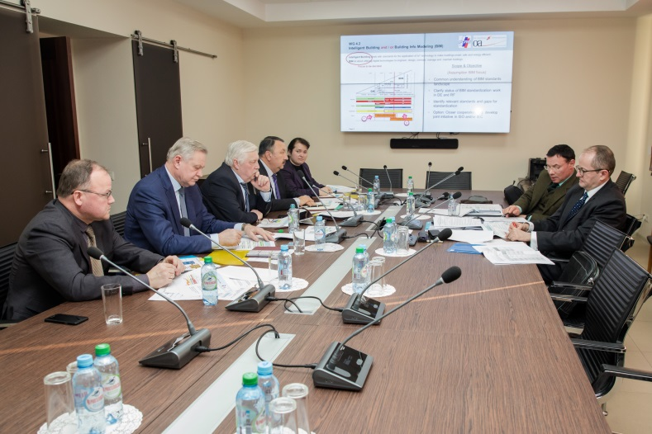
WORKING SEMINAR ON DIGITAL TRANSFORMATION IN RSPP
Council for technical regulation with OAOEV.
22.01.2019 - At the RSPP held a meeting with the Director of technical regulation and standardization of SIEMENS AG M. Reigl and head of the direction for cooperation with small and medium-sized businesses of the Eastern Committee of the German economy. Boehlmann :
German coordinators of the working groups of the Council have been approved;
The agreement on the participation of German experts in the "Russian Business Week" and the forum "Innoprom-2019" was reached.
5

Slide 7



START OF WORK OF THE WORKING GROUPS.
WG “RAILWAY”
22.02.2019 г. Round table at the Ministry of economy and energy of Germany on railway transport, Berlin:
A report was made on the work of the Council.
The goals and objectives of the WG on rail transport of the Council for technical regulation and standardization for the digital economy are outlined.
Support:
4

Slide 8
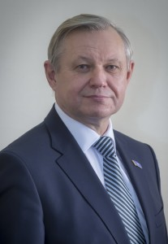
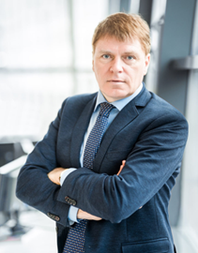
START OF WORK OF THE WORKING GROUPS.
WG “Machnery”
An agreement was reached to consider the aspects of "Industry 4.0" for mechanical engineering, taking into account new standards, new professional competencies and the development of bilateral cooperation between Russian and German industrial enterprises and universities.

Slide 9
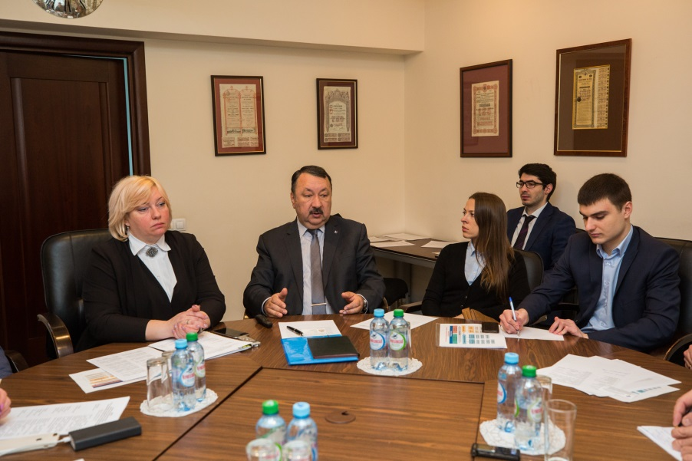
MEETING OF THE WORKING GROUP
CONSTRUCTION MATERIALS
March 6, 2019 in Russian Union of Industrialists and Entrepreneurs was a meeting of the Russian part of the Working Group “Construction materials" of the Council on technical regulation and standardization for the digital economy.
There were 20 experts from different Russian companies and Government bodies.

Slide 10
SCHEDULE OF WORK OF THE COUNCIL ON TECHNICAL REGULATION AND STANDARDIZATION FOR DIGITAL ECONOMY
BETWEEN RSPP AND EAST GERMAN BUSINESS ASSOTIATION
March, 2019
Meeting of the Council.
Report on the project and meetings of the working groups
Moscow, “Russian business week”,
November 29, 2018
Second meeting of the Council. Formation of working groups
Berlin
July 10-11, 2018
Signing of the Memorandum
First meeting of the Council. Alignment of project goals
Yekaterinburg, forum “Innoprom-2018”
Moscow, conference “IT-standard”
Yekaterinburg, forum “Innoprom-2019”
July, 2019
Meeting of the Council. Discussion on progress in the work
October, 2019
March, 2020
Moscow, “Russian business week”,
Presentation of recommendations
Meeting of the Council. Discussion of the recommendations
Moscow

Slide 11

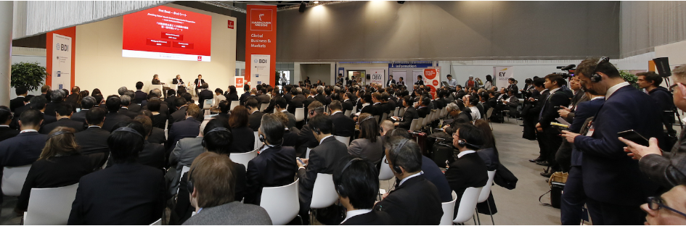





FUTURE PLANS
BUSINESS MISSION ON
STANDARDIZATION FOR THE DIGITAL ECONOMY AT HANNOVER-MESSE-2019
April 01-03, 2019
Organizers:
Supported by:

