Slide 1
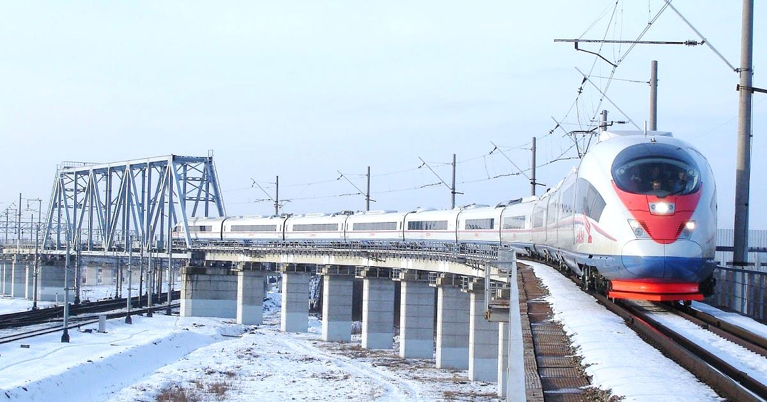
Итоги работы НП «ОПЖТ» за 2017 год и
задачи на 2018 год
Technical regulation and standardization in the railway industry of the Eurasian Economic Union
Gapanovich Valentin Alexandrovich
president NP «UIRE» vice-President of the Russian Engineering Union
© НП «ОПЖТ»

Slide 2
НП «ОПЖТ» в цифрах. Итоги работы за 10 лет
February 22, 2019 in the Ministry of Economics and Energy of Germany (Berlin) a working meeting was held between manufacturers of railway engineering products within the framework of the “German High-Speed Trade Initiative”

Slide 3
Основные направления деятельности в 2018 году
Questions and problems of technical regulation
Confirmation of compliance with the requirements of TR CU 002/2011 “On the safety of high-speed rail transport”: what should be considered the object of technical regulation?
Accreditation of test centers: where to test high-tech converter equipment?
Inspection control: how much testing is really needed?
List of standards: what requirements to check?
Applying other documents for conformity assessment purposes: how is this done?

Slide 4
НП «ОПЖТ» в цифрах. Итоги работы за 10 лет
Short answers to questions
The draft new version of the ТР ТС 002/2011 TR contains electric trains as an object of technical regulation; agreed by the EAEU countries; to be adopted in June-August 2019; will come into force in 2020
Testing of high-tech products is possible in test centers outside the EAEU: this requires an international agreement on mutual accreditation of applicants
The volume and frequency of testing during the inspection control are set by the certification body each time individually
Currently, a lot of work is underway to update each list of standards necessary to meet the requirements of ТР ТС 001/2011, ТР ТС 002/2011, ТР ТС 003/2011
Clauses 9 and 21 of Article 6 of the TR CU 002/2011 allow the use of other documents (not standards) to assess the conformity of products

Slide 5
НП «ОПЖТ» в цифрах. Итоги работы за 10 лет
What's next?
It is necessary to continue the work by expanding the membership of the meetings of the Railway Transport Working Group of the Council for Technical Regulation and Standardization for the Digital Economy of the RSPP Committee and the Eastern Committee of the German Economy, inviting all participants of the German Initiative for the development of high-speed lines and other interested parties

Slide 6
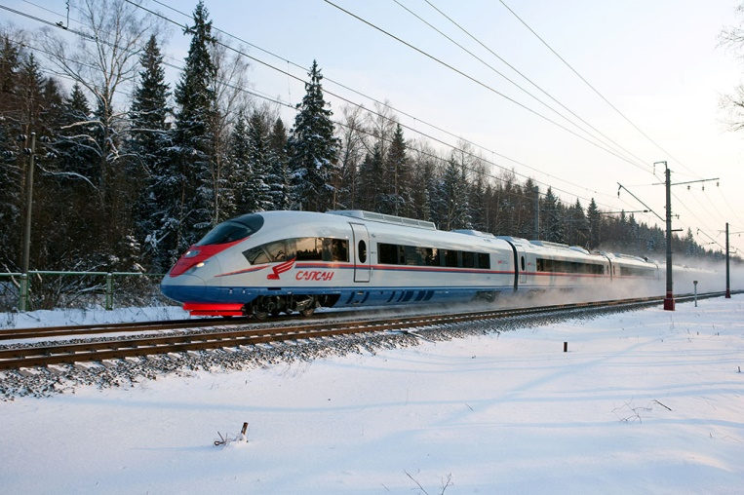
Thank you for your attention!
Address: 107996, Russian Federation, Moscow, Riga Square, 3
Phone: +7 (499) 262-27-73
Fax: +7 (499) 262-95-40
E-mail: opzt@opzt.ru
© НП «ОПЖТ»

