Slide 1


Standardization for
Smart IoT Systems and Industry 4.0
Markus Reigl (Dipl.-Ing., M.A.) Siemens AG, Munich/Germany

Slide 2
Content
  The challenge: Smart-X everywhere
  The standardisation landscape for Smart-X
  The German industry pragmatic approach to cope
  The Outcome: publications, findings, experience

Slide 3
Content
  The challenge: Smart-X everywhere
  The standardisation landscape for Smart-X
  The German industry pragmatic approach to cope
  The Outcome: publications, findings, experience

Slide 4
Smart-X [ X = City, Grid, Building, Vehicle, Factory, …]
Merely connecting domain specific IoT islands …
Permanent Power
Intelligent Traffic
Volatile Power
Smart Factory
Local Power
Smart Building
Power Management
Intelligent Healthcare
… make no holistic system!

Slide 5
After All …
Evolution will lead to Web of Things (Systems)
Internet
World Wide Web
Web 2.0
Web of Systems
www
ARPANET
TCP/IP
http
VoIP
Mobile web
Social media
Smart grid
i4.0
Smart city
~1970
~1990
~2010
~2020

Slide 6
Smart-X
Universal, domain-independent standards will allow …
Permanent Power
Intelligent Traffic
Volatile Power
Smart Factory
Local Power
Smart Building
Power Management
Intelligent Healthcare
… for the holistic functional integration!

Slide 7













What is missing to provide the glue ?
Rule of thumb heuristics: 80% ready / 20% missing
ERP/MES/PLM/…
Standards for
Contextualization
of services and data
Semantic Object / Service Descriptions
OWL OWL-S OMM++
USDL WSDL
Unified function description
7
SoA services
Interoperability
standards
6
OPC-UA, IEC 61850, BACnet, ...
5
4
IP
Communication
standards
3
2
Ethernet, WLAN,
ZigBee, 5G, ...
1
Source: Adapted from Prof. Wahlster, DFKI

Slide 8
Content
  The challenge: Smart-X everywhere
  The standardisation landscape for Smart-X
  The German industry pragmatic approach to cope
  The Outcome: publications, findings, experience

Slide 9
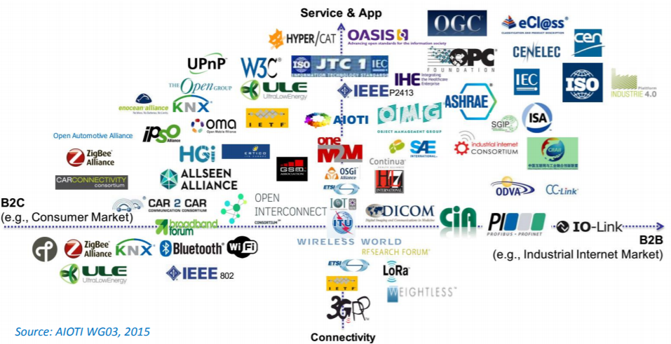
Hundreds of SDOs, Committees and projects in arena e.g. 250 relevant to Siemens

Slide 10




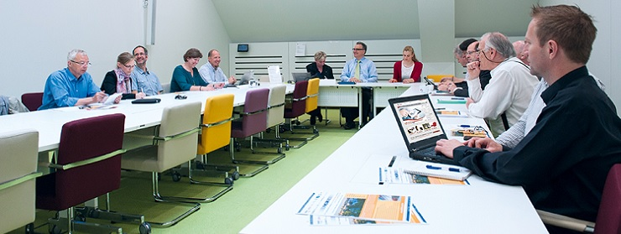
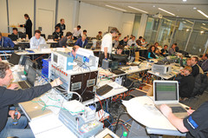
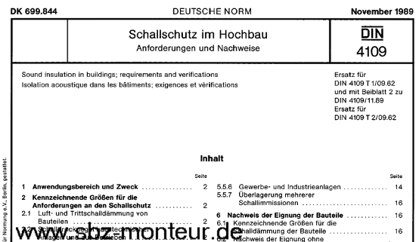


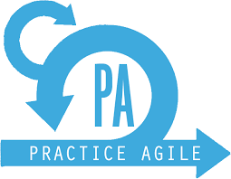
Work in fora and consortia
The standard is minimum consensus and running code

Slide 11
Content
  The challenge: Smart-X everywhere
  The standardisation landscape for Smart-X
  The German industry pragmatic approach
  The Outcome: publications, findings, experience

Slide 12
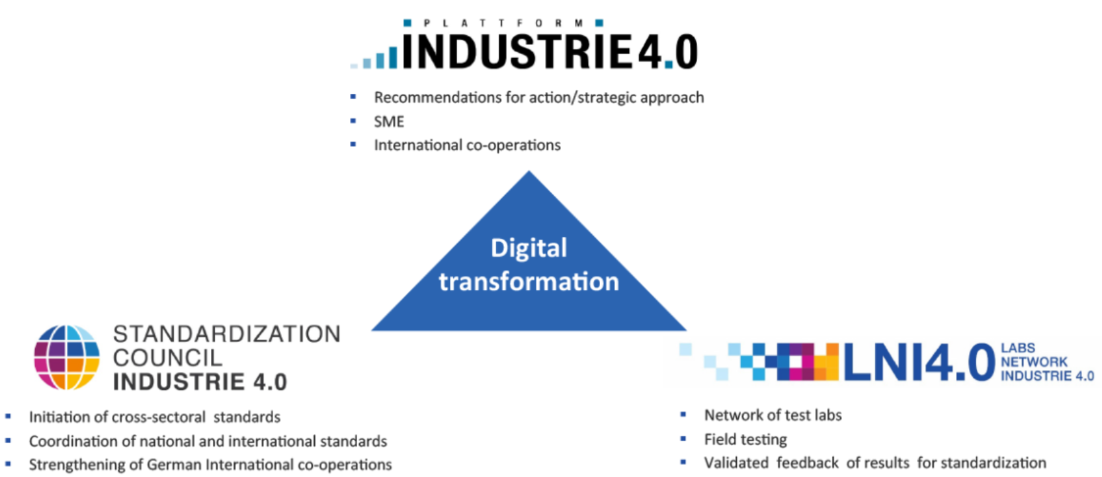
ORGANISATIONAL Approach
Structure for policy, steering/making and testing

Slide 13

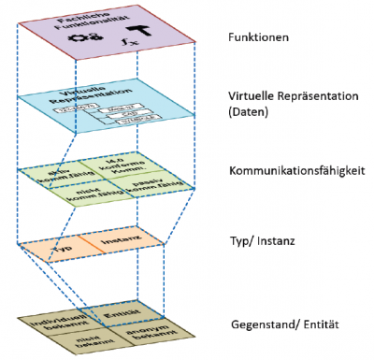
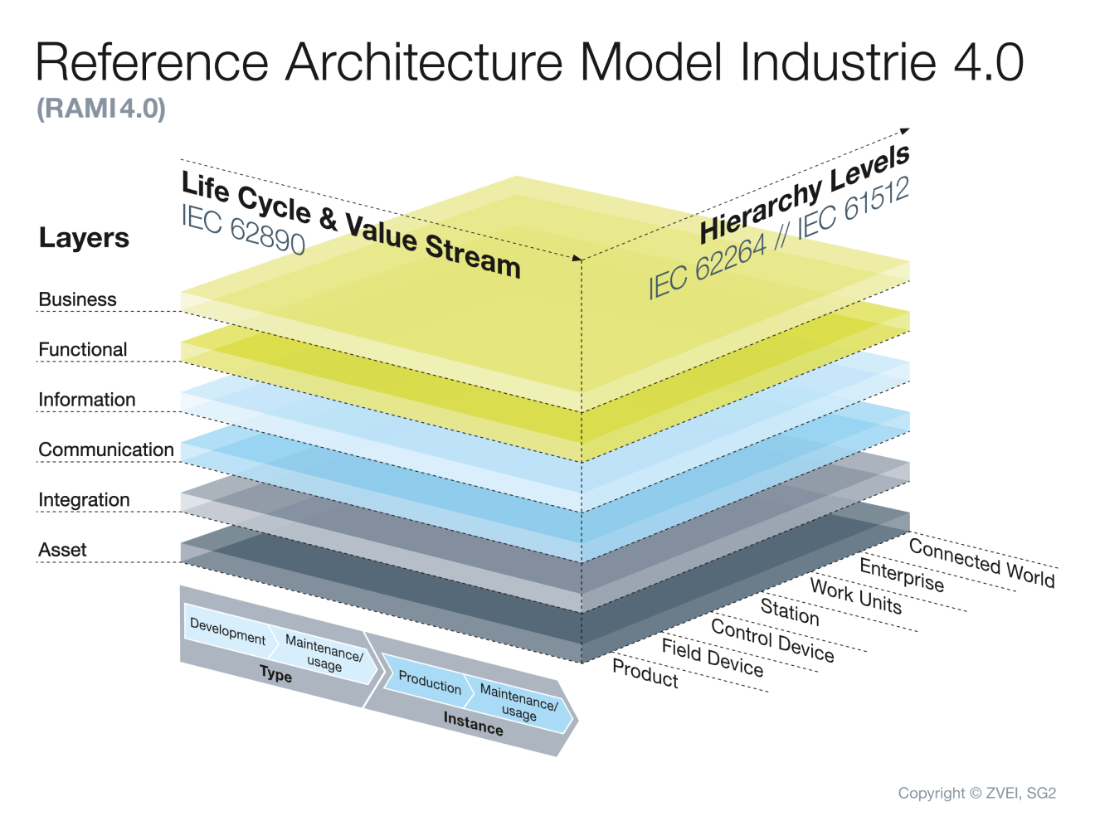
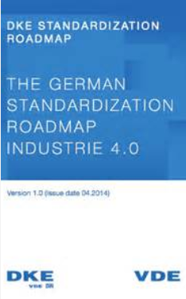
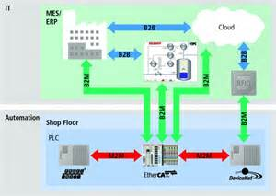
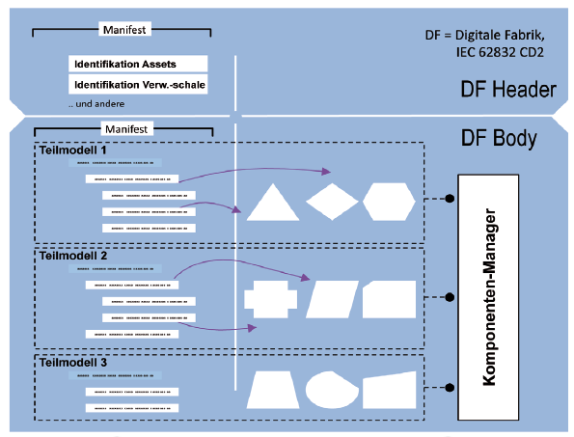
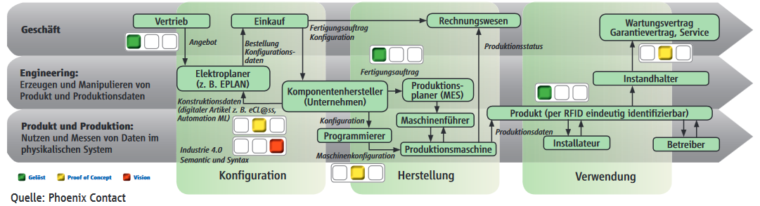
TOP DOWN Approach
Use Cases ➔ Roadmap, Architechture Frameworks➔ Models
DIN SPEC 91345
DIN EN 62541
Asset Admin. Shell (AAS)

Slide 14

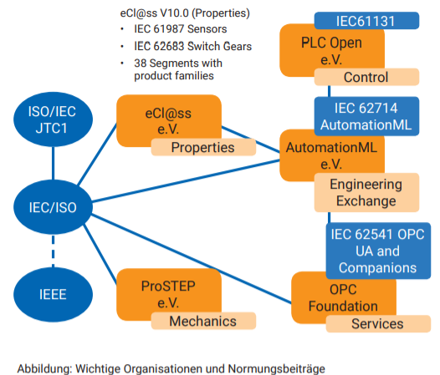
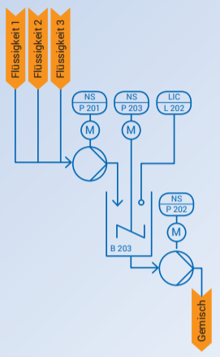
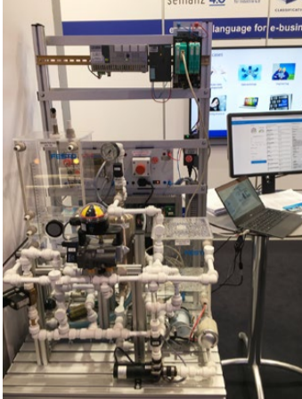
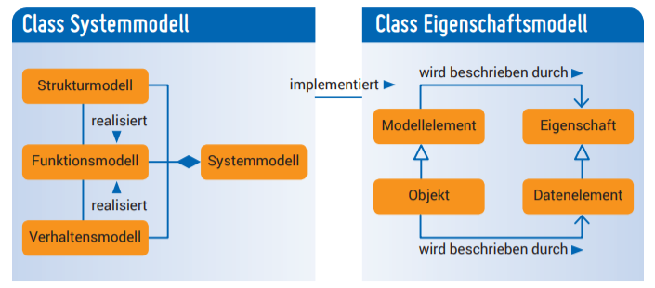
BOTTOM UP Approach
Example: Integration based on Industrial Semantics

Slide 15
Content
  The challenge: Smart-X everywhere
  The standardisation landscape for Smart-X
  The German industry pragmatic approach to cope
  Outcome: publications, findings, experience

Slide 16
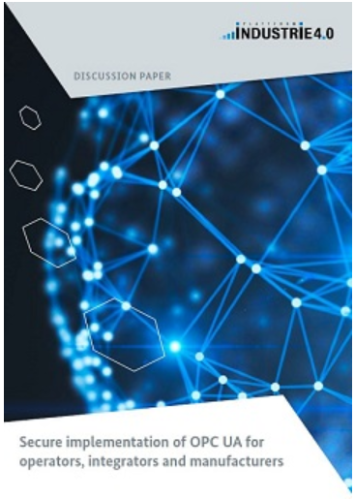

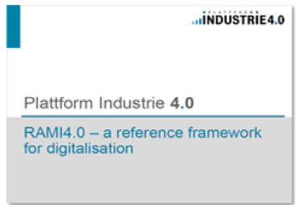
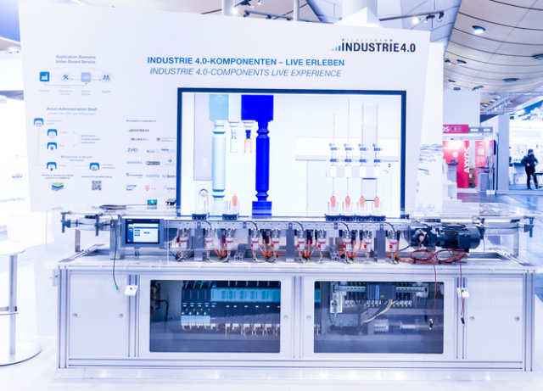
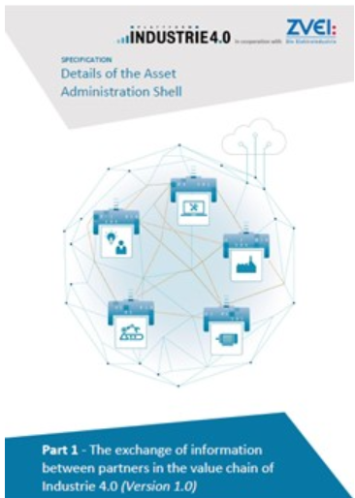
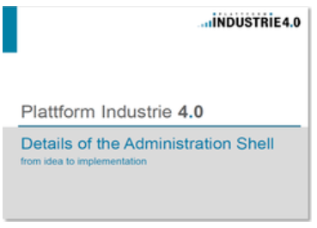
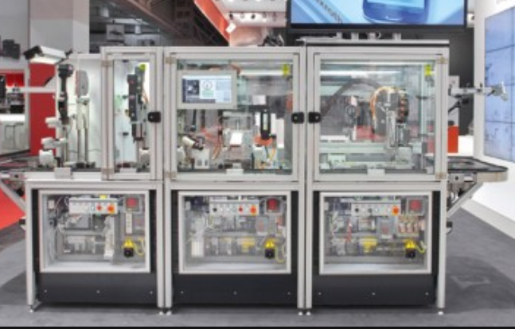
Find relevant Publications in English …
Find relevant Standards at ISO/IEC, DIN / VDE / VDI, GitHub, …
Find Proof-of-Concept Demonstrators at Hannover Tradefair …
Plattform: https://www.plattform-i40.de/I40/Navigation/EN/Home/home.html
Use Cases: https://www.plattform-i40.de/I40/Navigation/EN/InPractice/UseCases/use-cases.html
Online Library: https://www.plattform-i40.de/I40/Navigation/EN/InPractice/Online-Library/online-library.html
W3C WoT Interest Group / GitHub Repository: https://github.com/w3c/wot

Slide 17


