Slide 1
Challenges for European Plant and Mechanical Engineering Companies in the Assessment of Technical Requirements in the Russian Federation

Slide 2
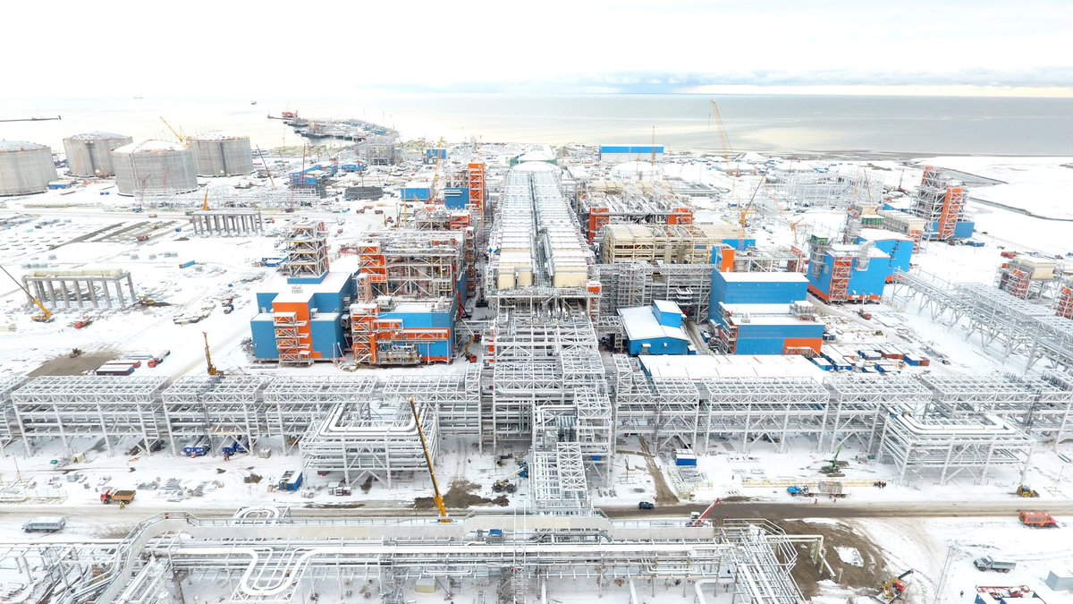
“The clash of engineering cultures” ???????
Clash |Challenges | Solutions| Contact
Yamal Project: ©EPC TechnipFMC

Slide 3
Challenges versus new objectives in the RF
Clash | Challenges | Solutions| Contact
Competitive and price pressure
Re-adjustment of EPC business model
Conformity assessment involves a set of processes that show your product, service or system meets the requirements of a standard(system).
Global risk increase
Digitalisation versus over-regulation

Slide 4
Technical Regulation (TR CU 004, 010, 012, 016, 020, 032…), DEC GOST, RTN P2U, Recalculation, TP, Seismological report, PAC RF, PCC RF, Calibration methods, Expert Report, Glavgosexpertiza, Rostechndazor, deep and deepest environmental conditions, ISO GOST, PB, pressure vessules and piping, high voltage, testing of EMC
Clash | Challenges | Solutions| Contact
How can the European EPC meet the Technical Conformity in Russia while facing the challenges and the “controlled and regulated environment”?

Slide 5
Potential Solutions
Clash | Challenges | Solutions| Contact
Local Content
Services in the life cycle of a plant
New approaches: Modularization, ”Cost Plus Model”, ALPHA IMCA (Integrated Modular Conformity Assessment) for the Modularization in Plant Engineering
New methods of project work and digitalization, digital twins
harmonization of technical regulation on mutual acceptance (OAOEV)

Slide 6
Thank you for your attention! thomas.krause@alpha-consulting.eu
Clash | Challenges | Solutions| Contact

