Slide 1
Standards – an enabler for holistic system design and industrial integration Markus Reigl (Dipl.-Ing., M.A.) Siemens AG, Munich, Germany

Slide 2
Smart-X [ X = City, Grid, Building, Vehicle, Factory, …] Merely connecting domain specific IoT islands …
Permanent Power
Intelligent Traffic
Volatile Power
Smart Factory
Local Power
Smart Building
Power Management
Intelligent Healthcare
… make no holistic system!

Slide 3
After All … Evolution will lead to Web of Things (Systems)
Internet
World Wide Web
Web 2.0
Web of Systems
www
ARPANET
TCP/IP
http
VoIP
Mobile web
Social media
Smart grid
i4.0
Smart city
~1970
~1990
~2010
~2020

Slide 4
Smart-X Universal, domain-independent standards will allow …
Permanent Power
Intelligent Traffic
Volatile Power
Smart Factory
Local Power
Smart Building
Power Management
Intelligent Healthcare
… for the holistic functional integration!

Slide 5
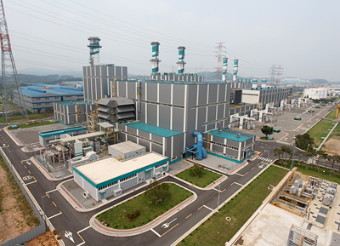
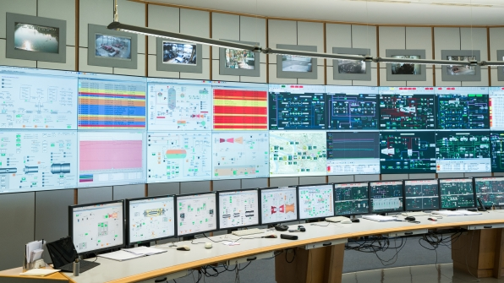
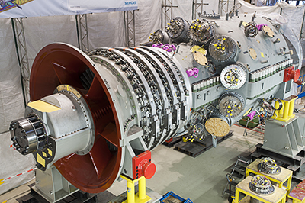
Smart-X: Product ➔ System ➔ Plant … it is all about Engineering …
Plant
e.g. ISO/TC242
System
e.g. ISO/TC184
Product
e.g. ISO/TC192
Many Standards available from ISO, IEC and Others
All Pictures: Siemens

Slide 6
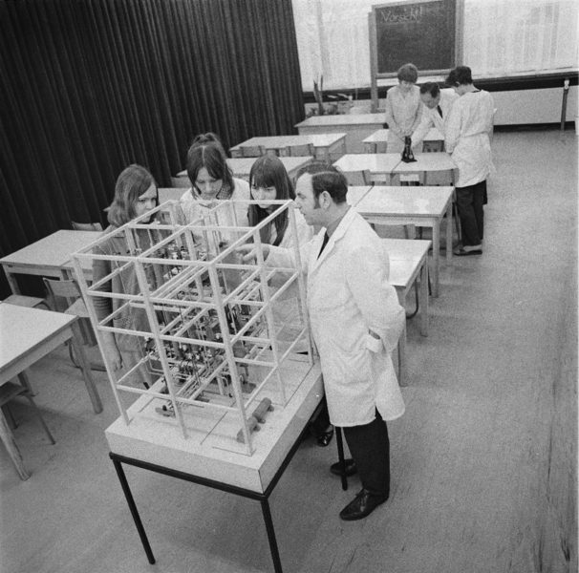
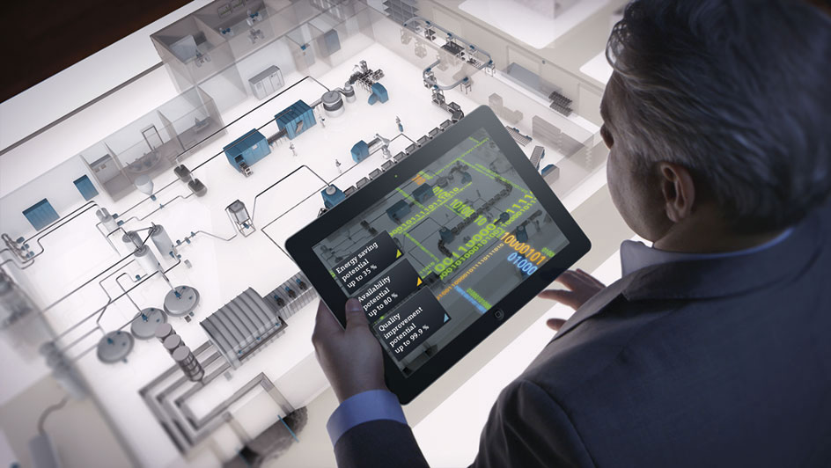
Smart-X: Engineering remains the core value … What standards do we need to cater for 2030 needs?
1970
2000
2030
Picture: Siemens
C_{E} ≈ 0,05 C_{P}
Picture Source: CADcompany
Picture: Deutsche Digitale Bibliothek
C_{E} ≈ 0,1 C_{P}
C_{E} ≈ 0,2 C_{P}

Slide 7
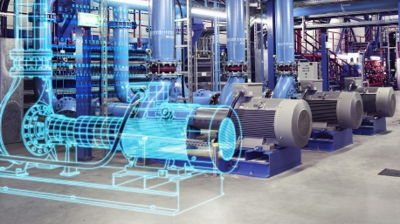
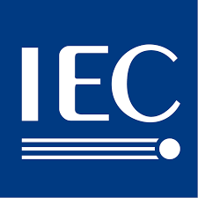
To enable the year 2030 engineering ➔ need standards for the digital twin
Product design
Production planning
Production engineering
Production execution
Services
CAx Tool Landscape: TeamCenter, NX, COMOS, AutomationDesigner, Technomatix
Product Data Library, based on semantic standards
ISO/TC 37 is providing some good fundamental/basic standards for terminology and semantics!
Industries must engage in projects to provide semantic content for their respective fields!
Generic Frameworks are not enough
Product related contend is needed

Slide 8
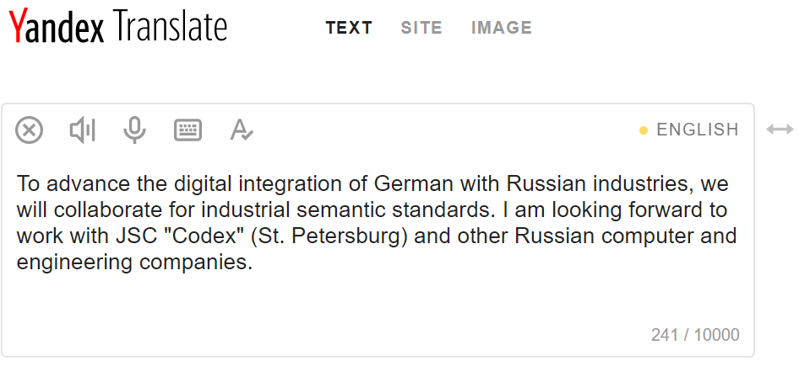
This Yandex site shows the power of web services ➔ to be utilized for Smart-X

