Slide 1
Innoprom 2019 - German-Russian Initiative for Digitalization (GRID): Results and Prospects
Areas for future cooperation
Jens Böhlmann,
Head of Department for SME German Eastern Business Association
Ekaterinburg,
10th of July 2019

Slide 2
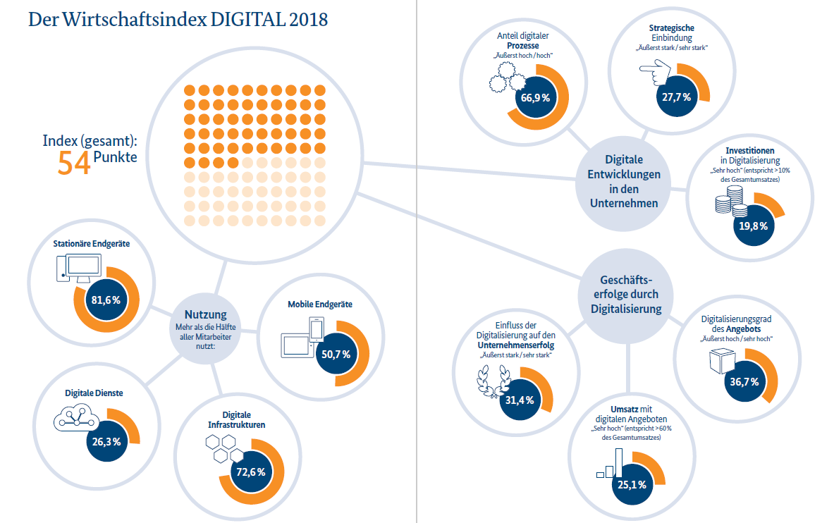
Degree of Digitalization in the German Economy
Digital Index
Digital process ratio
Investments
Devices
Digital influence on companies success

Slide 3
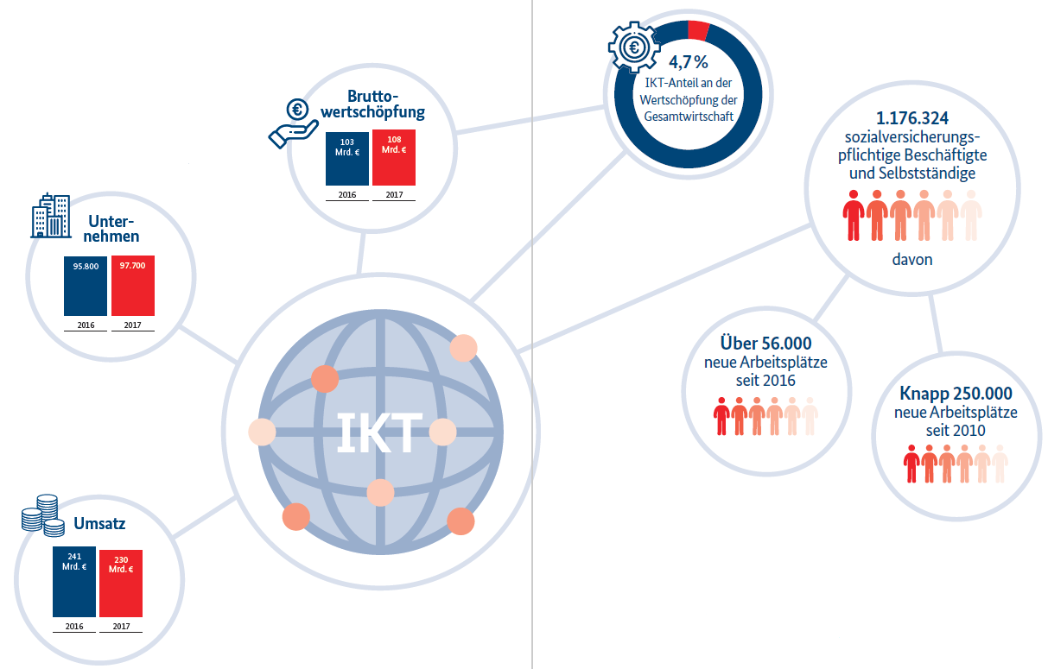
German Digital Industry at a glance
Gross Value added
Companies
Employees
Turnover

Slide 4
Budget share - innovations by industry in Germany (%)

Slide 5
Framework for ICT in international comparison

Slide 6
Availability of venture capital in international comparison

Slide 7

German (digital) Footprint
German Russian Initiative for Digitalization
German Russian Initiative for Technical Regulations
German-Russian Efficiency Partnership
Made in Germany – competitive advantage
German companies very popular
Quality, reliability, sustainability, service
Loyalty to the Russian market
High end technology (IT)
World export champion

Slide 8

Advantages of the Russian IT industry
Huge innovative startups
High flexibility
Excellent specialists
Strong willingness to cooperate
High level of professionalism
National players (yandex, mail.ru, ozon.ru)
Marketplace „beru.ru“
Fast growing e-commerce
Software development
Software design

Slide 9

Areas for cooperation
Automotive industry
Smart Cities
Healthcare
BIM Technologies
ICT
Machinery (Industry 4.0)
Harmonization of Technical Regulations
E-Commerce
Venture capital
Artificial intelligence

Slide 10



Slide 11
Jens Böhlmann
Leiter Kontaktstelle Mittelstand
Ost-Ausschuss – Osteuropaverein der Deutschen Wirtschaft
Breite Straße 29
10178 Berlin
Besucheranschrift:
Gertraudenstraße 20
Telefon: +49 30 206167-127
Mobil: +49 151 727 14917
Fax: +49 30 2028 2 516
E-Mail: j.boehlmann@bdi.eu
Internet: www.oaoev.de

Slide 12
Thank you for your attention

